Slide 1

Equipping the Next Generation for Active Engagement in Science
Sinking island

Slide 2


Objectives
To use what you know about climate change to explain rising sea levels.
To make a prediction about rising sea levels and estimate the uncertainty in your prediction.

Slide 3

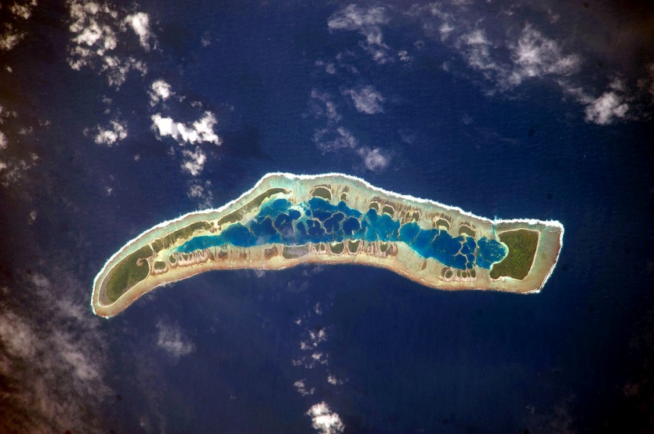
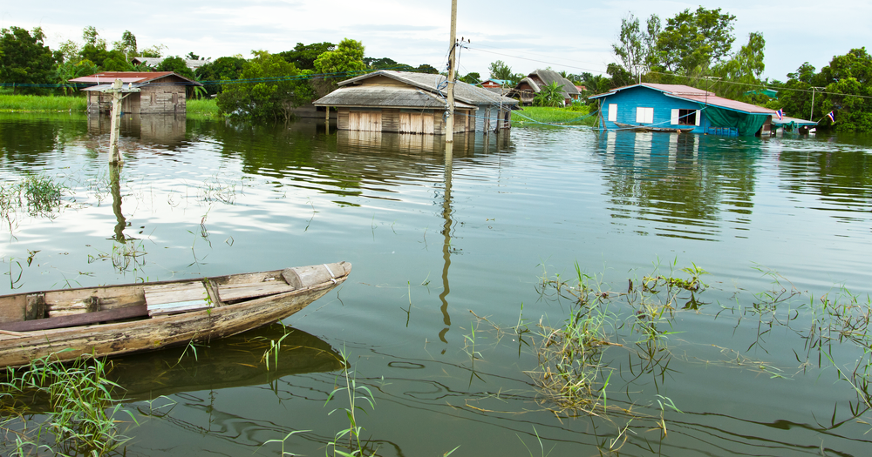



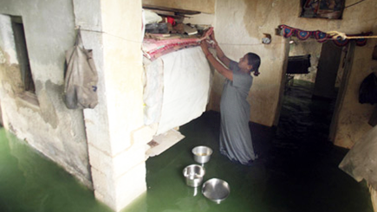
DAILY NEWS
ISLAND TRAGEDY
Two tiny Kiribati islets are already beneath the Pacific.
Islanders fear that rising seas will soon submerge more of Kiribati’s
32 islands.
This used to be my living room.
I’m saving what I can
… but I will never return.
My home is disappearing under the sea.
STARTER
3

Slide 4

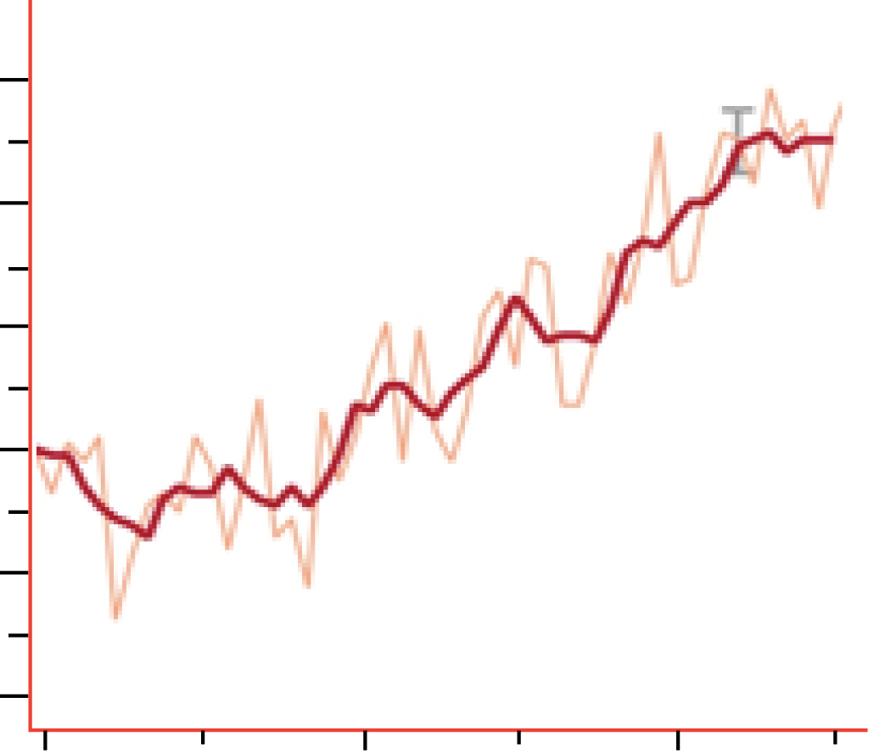
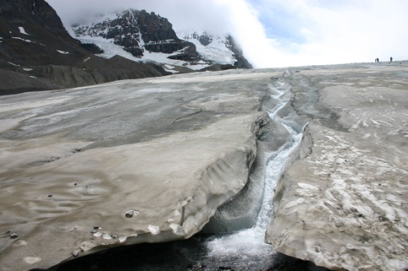
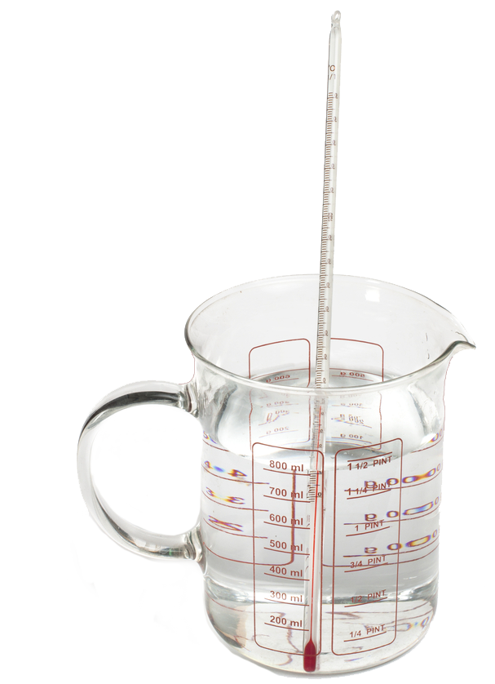


Use the graphs and pictures to explain rising sea levels.
What makes sea levels rise?
Global temperature
0.6
0.4
0.2
0
–0.2
–0.4
Global temperature difference (ºC)
glacier (ice)
liquid water
1960 1970 1980 1990 2000 2010
year
400
380
360
340
320
Carbon dioxide concentration
Carbon dioxide concentration (ppmv)
Seawater expands on heating
year
STARTER
4
1960 1970 1980 1990 2000 2010
4

Slide 5
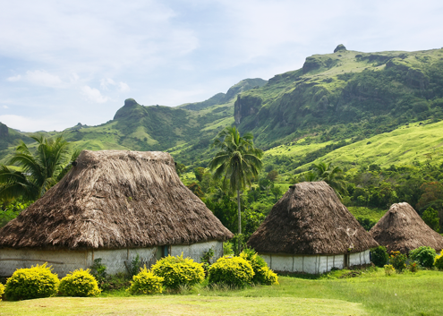


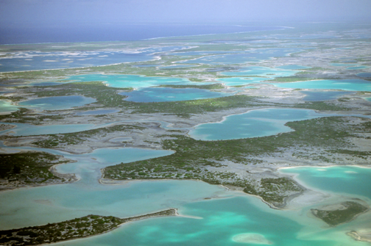

Fiji
SS1
We have
bought land in Fiji for our people to escape to when the time comes.
Photocredit: Sam Beebe
President Tong of Kiribati
When will the sea submerge other Kiribati islands?
Examine the evidence and make a prediction.
Estimate the uncertainty in your prediction.
Kiribati
CORE TASK
5

Slide 6
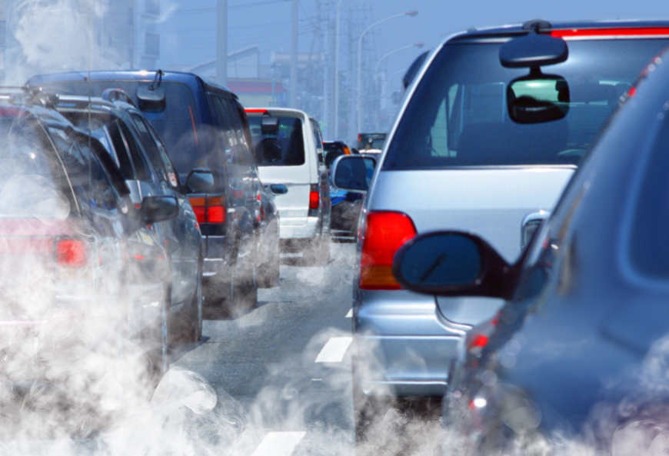
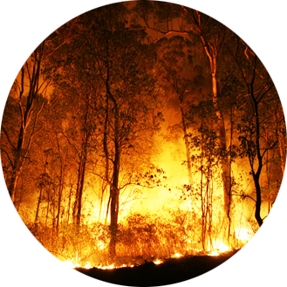


SS2 – 6
Climate change makes sea levels rise.
Are humans to blame for climate change?
Weigh up the evidence and make a conclusion.
Can you be sure your conclusion is correct?
EXTENSION
6

Slide 7




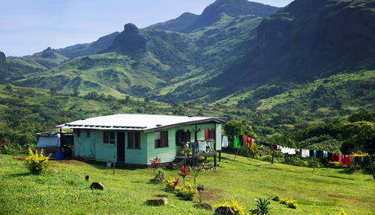
If humans are to blame for climate change…
Should the countries that make
the most carbon dioxide buy land for
vulnerable islanders to escape to?
Vote yes or no.
How did you decide? Were all your reasons scientific?
PLENARY
7

Slide 8

Get students talking and thinking

Slide 9












Equipping the Next Generation for Active Engagement in Science
TRACES

